Slide 1

YSeriously - Transforming Note-Taking with AI
Welcome to our presentation on YSeriously, a revolutionary app that utilizes AI to revolutionize the way you take notes and engage in meetings.

Slide 2
Introduction
YSeriously is an innovative app that acts as your AI meeting assistant.
It records speech, identifies key points, and translates them into multiple languages, facilitating seamless communication.

Slide 3
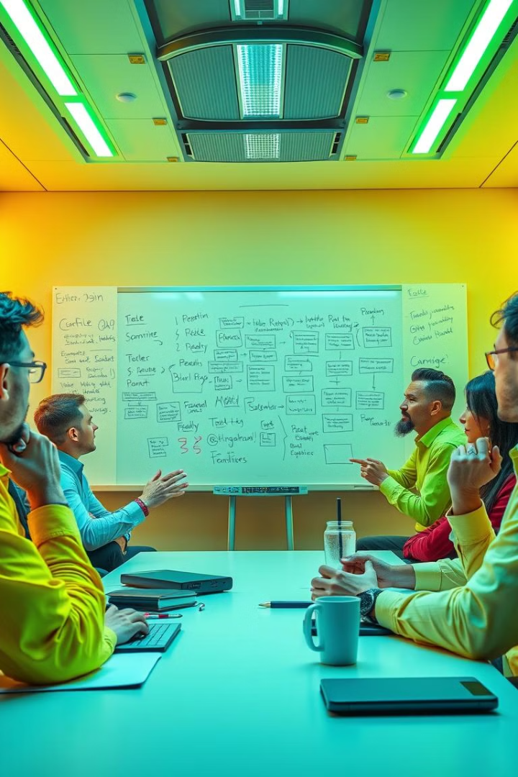
Problem Statement
Challenges of Traditional Note-Taking
Inefficient Processes
Traditional methods are often inefficient and incomplete, leading to missed information.
Keeping up with key information during busy meetings is a common struggle.

Slide 4
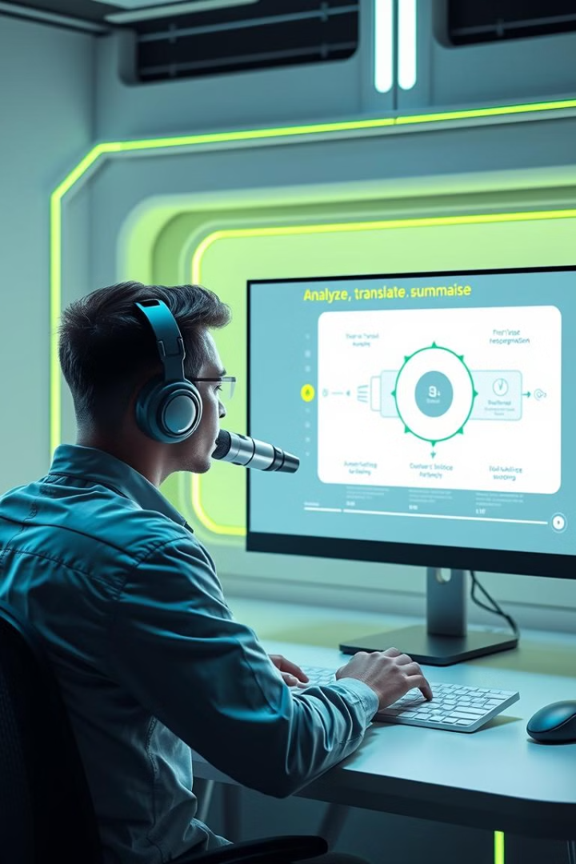



Our Solution
AI-powered Note-Taking
YSeriously attends your meetings, transcribing speech in real-time.
Intelligent Summarization
Our AI engine summarizes key points, ensuring nothing important is missed.
Multi-language Support
Notes are translated and read out in multiple languages for seamless communication.

Slide 5
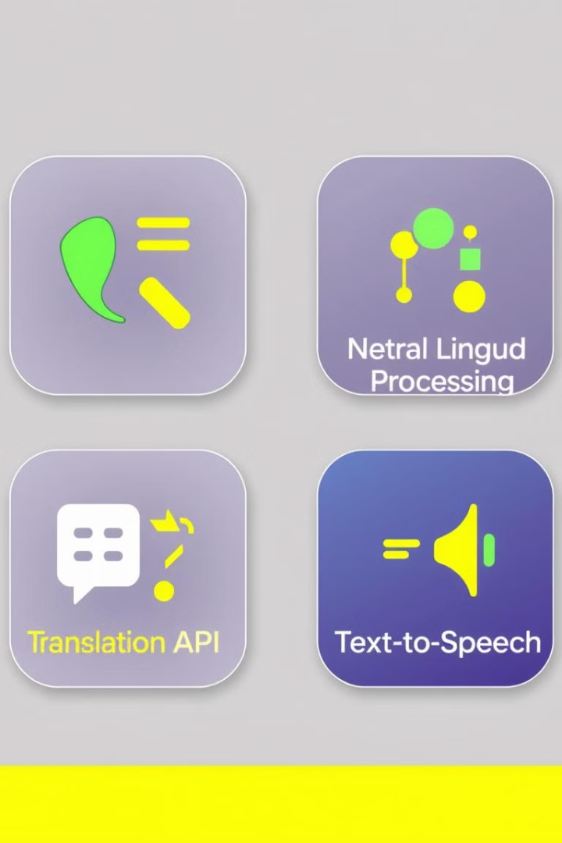




Technology Stack
Speech-to-Text
NLP
Real-time speech recognition.
Summarizing key points.
Translation APIs
Text-to-Speech
Multi-language support.
Reading out notes.

Slide 6
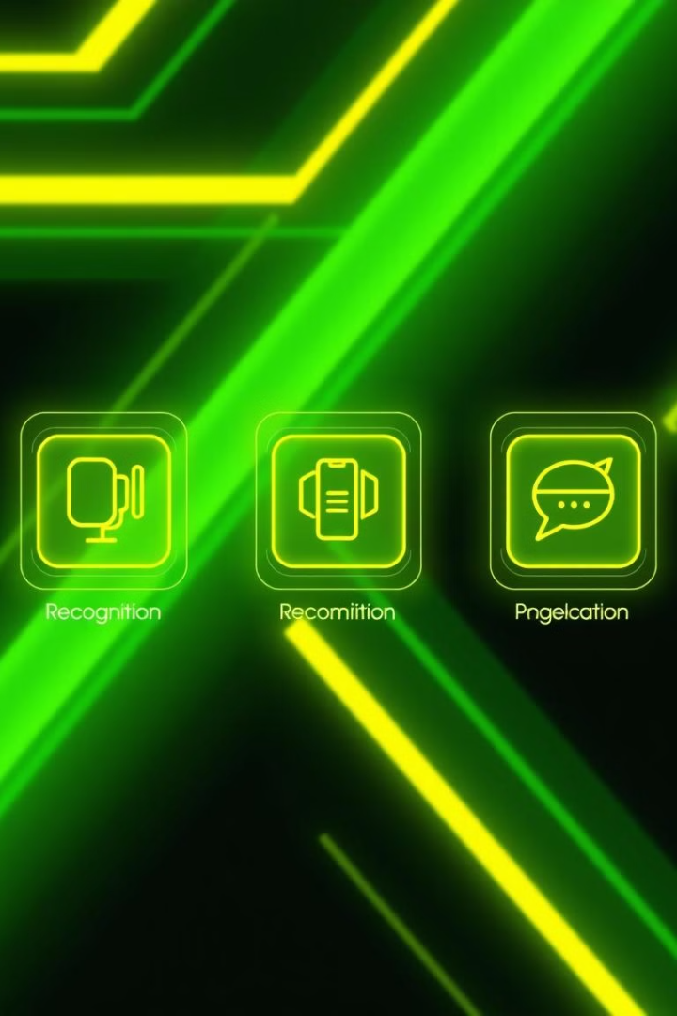
Key Features
Real-Time Recognition
Key Point Summarization
Capture every word spoken during meetings.
Concise summaries to quickly review the most important information.
Multi-language Support
User-Friendly Interface
Translate and read out notes in various languages.
Intuitive design for seamless interaction.

Slide 7

Thank You
Thank you for your time and attention. We are excited to continue developing YSeriously for smarter meetings!

